Slide 1
HR Analytics
Dashboard Overview
By Sharada Prasanna Rout

Slide 2
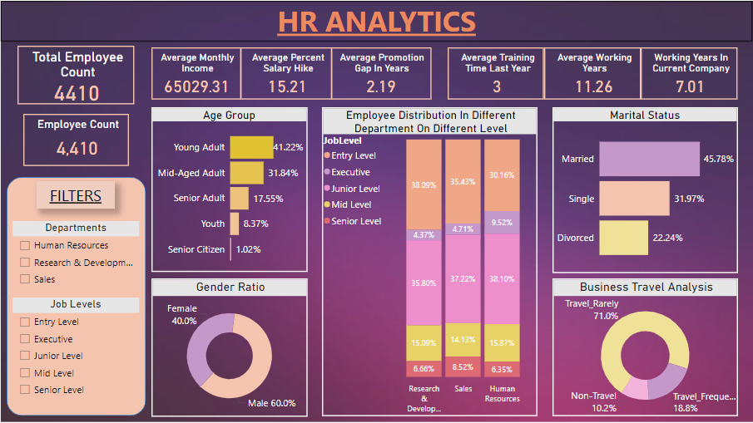
Dashboard Title

Slide 3
Total Employee Count Irresponsive To Filters
Total Employee Count Responsive To All Filters

Slide 4
Filters Section
Consist Slicers Of Two Fields i.e.
Department
Job Levels

Slide 5

Monetary or Financial Related Details That Excites Employee The Most

Slide 6
Details That Provide Context And Demonstrate Practical Experience For An Employee

Slide 7
Main Interactive Dashboard Consist Of dg
Main Dashboard
Which Focus On Relevant Data, Tailored As Per Requirement

Slide 8
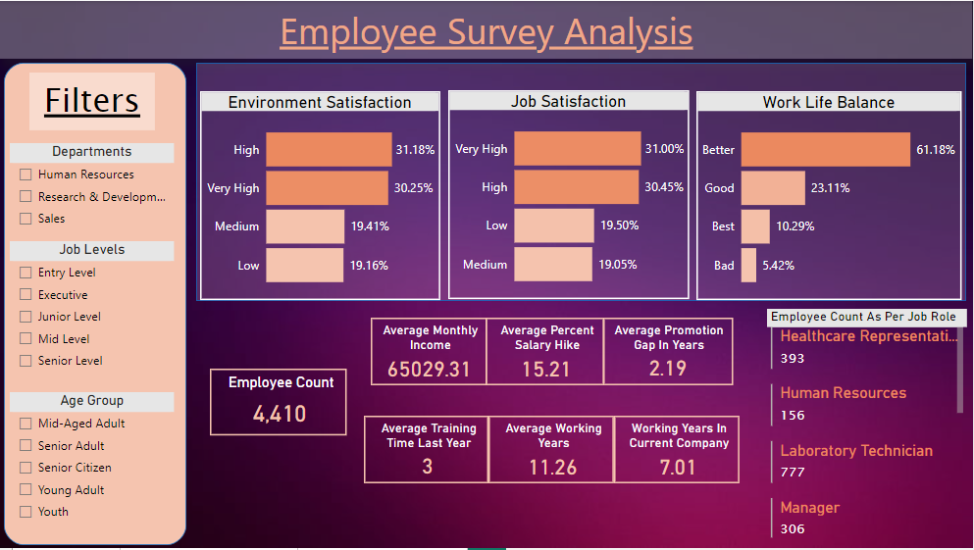
Dashboard Title

Slide 9
Filters Section
Consist Slicers Of Fields Mentioned Below
Department
Job Level
Age Group

Slide 10
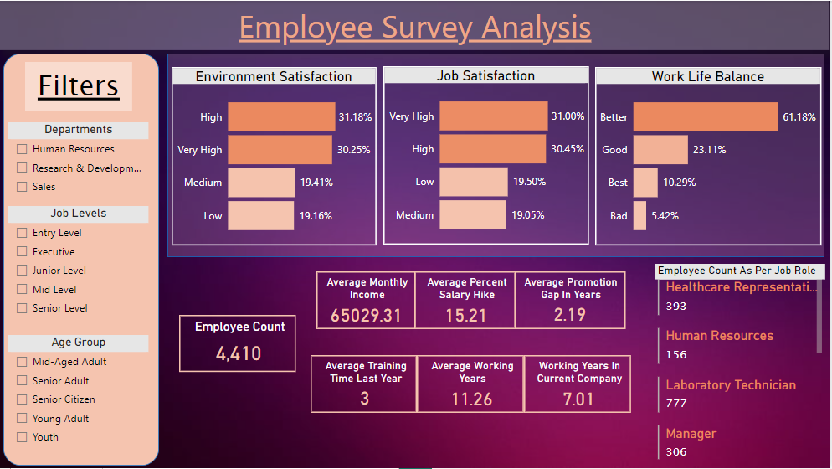
Employee Survey Results In Form OF Visuals

Slide 11
Key Result Indicators For Employee Survey

Slide 12
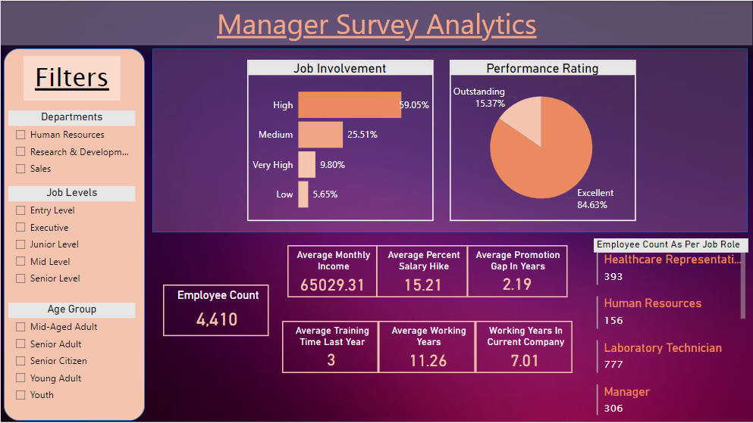
Manager Survey Has A Similar Interface As Employee Survey Analysis

Slide 13
Thank YOU

